Slide 1
Computer Vision
Lecture 6 a
Simon McLoughlin

Slide 2
Overview
Stereo Vision
Simple Reconstruction
Correspondence Problem

Slide 3
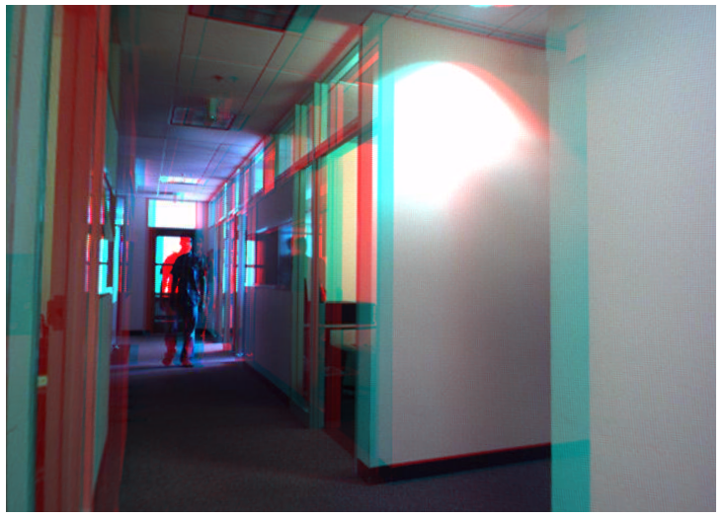
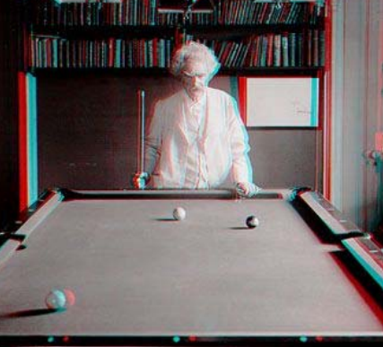
Stereo - Anaglyphs
Anaglyph 3D is the name given to the stereoscopic 3D effect achieved by means of encoding each eye's image using filters of different colors, typically red and cyan.

Slide 4
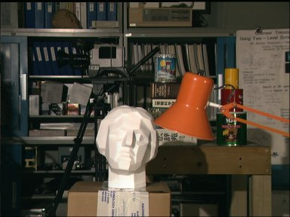
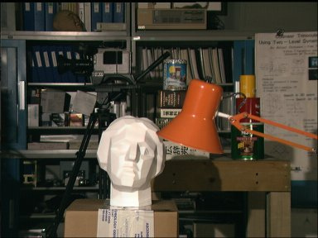
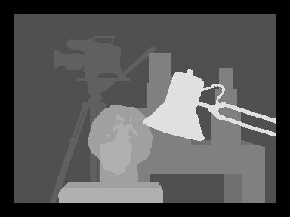
Stereo Depth Map

Slide 5
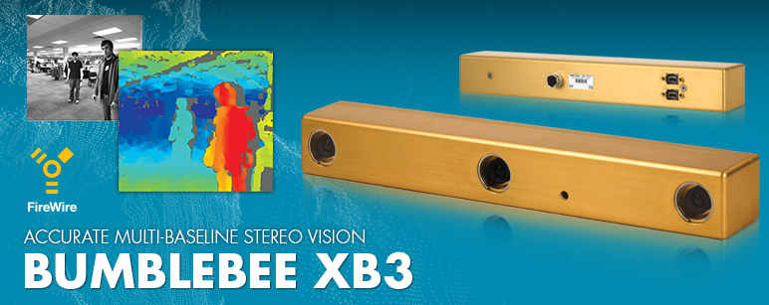
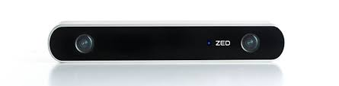
Machine Vision - Stereo
There are a number of commercial stereo vision systems currently available but they will not suit every application! You may need a custom design or DIY system

Slide 6
Machine Vision - Stereo
So the basic premise is to use the horizontal offset (called disparity) for a scene that arises from two images taken of a scene with some shift between the camera(s)
The disparity will not be fixed, it will get smaller the further the object is from the camera(s) so the disparity is inversely proportional to depth
This pair if images (called a stereo pair) can be obtained from two cameras displaced laterally that take one image each or from a single camera that moves laterally and captures the images before and after the move
If using two cameras they should be synchronised so they capture at the same time (can handle scene motion), with a single camera the scene should be static

Slide 7
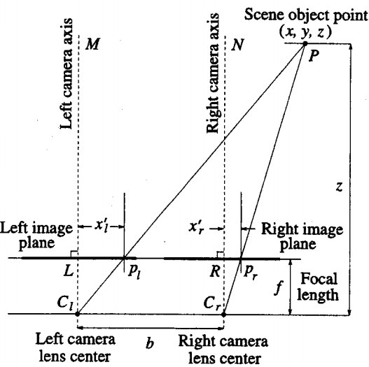



Stereo – the Mathematics
From similar triangles we have:
and
From these 2 we can get

Slide 8
Machine Vision - Stereo
So is it that simple? Can we just place two cameras side by side and calculate disparities? What complexities are there if any?
We need to know the focal length (f). We may be able to use the lens nominal value but this changes slightly as you adjust focus
The configuration on previous slide is a simple fronto-parallel configuration where it is assumed the left and right cameras are identical and are perfectly aligned with each other (the scanlines are coincident)
Even if we had a perfect fronto-parallel configuration and we know the exact focal length and pixel size we still need to solve one problem? The correspondence problem.

Slide 9
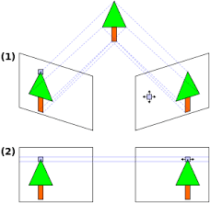
Stereo Vision – Correspondence Problem
For a point in the left image, determine the point in the right image that it corresponds to
Let us assume for the moment that the cameras are fronto-parallel then this involves a search along a scanline (an image row) in the right image
The simplest approach is to extract a feature in the left image (e.g. an edge or a corner) and then look for it along the corresponding line in the right image using some similarity metric

Slide 10
Correspondence Problem – Feature Types
Edges – we can represent an edge at a particular point using attributes such as edge strength, orientation, intensity profile near the edge (e.g. bright to dark)
Corners or interest points – There are many techniques for finding these kind of features (Moravec, Harris, SIFT etc). They are essentially points in the image that have high discriminatory power e.g. corners, isolated points of local maximum/minimum intensity, endpoints, points of high curvature etc
Regions – regions (e.g. connected components) can be matched also based on their attributes. Be careful though as the projection of the object can look different in each camera due to perspective distortion

Slide 11
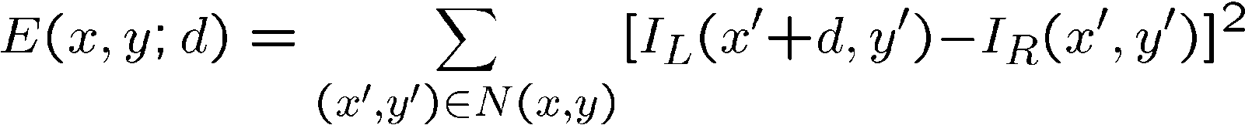
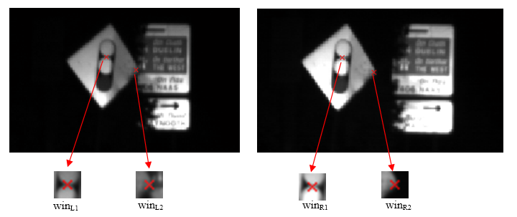
Matching metrics – Block Matching
A common method of matching interest points is through block matching where we define a neighbourhood around an interest point (e.g. corner) and use the SSD (sum of squared differences) to match it in the other image
where d is the disparity

Slide 12
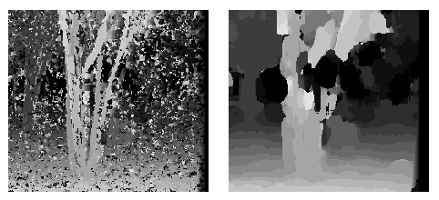
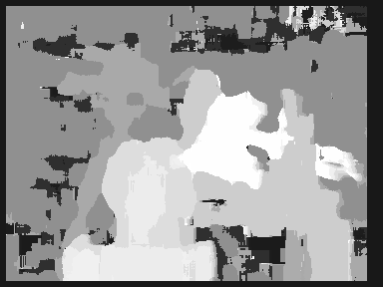
Matching metrics – Block Matching
How big should the neighbourhood be?
Smaller neighbourhood means more detail
Larger neighbourhood means fewer incorrect matches
Block matching can also be applied to every pixel on a row (as opposed to a feature). This will give a dense depth map (see openCV StereoBM)

Slide 13
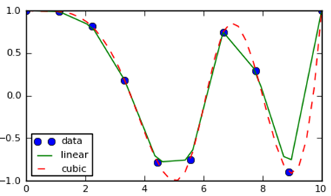
Matching metrics – Sub-pixel Block Matching
The image is composed of a number of discrete samples of the continuous scene projection
When we find matching pixels we can only say they represent the same projected point up to the size of a pixel
To improve depth resolution and accuracy we can perform sub-pixel stereo matching where we interpolate the grey levels and resample at a finer resolution
Then we can match at this finer scale to improve accuracy

Slide 14
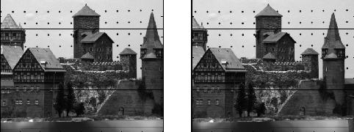
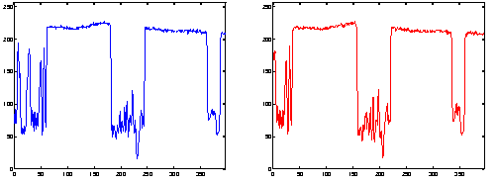
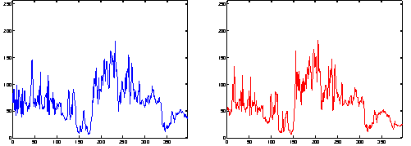
Stereo Matching – Global Matching
Another approach that is taken is to match the whole line of one image with that of the other based on the intensity profile
The goal here is to find for each pixel in the left line profile a match in the right line but the cost measure is global across the whole line – this help reduce the number of incorrect matches

Slide 15
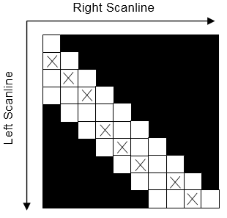
Stereo Matching – Dynamic Programming
Dynamic programming is one global technique that is used to match two scanlines.
The total cost function can be considered as the path through a 2D grid where each grid element has a specific cost associated with it
The cost of visiting a cell on the path is normally measure of the dissimilarity between the pixel values defined by the cell location (GL differences)
A global cost function can then be calculated as a sum of the pixel matching costs while taking into account penalties for any pixels in the scanlines that are unmatched due to foreshortening or occlusion.
As the algorithm proceeds the cost associated with each cell in a column is accumulated with the minimum cost of the cells in the previous column. When it reaches the end it looks backwards through the smaller costs to find the correct path.
The lowest cost path for a single scanline (X cells). In this case there is a maximum allowable disparity of three pixels.

Slide 16
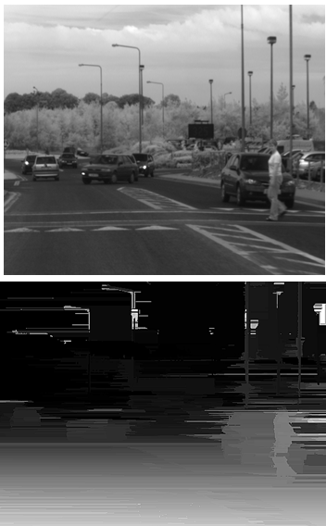
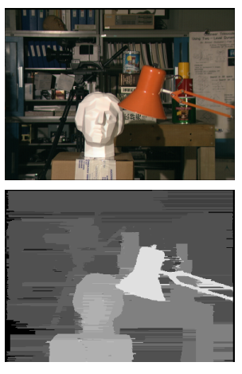
Stereo Matching – Dynamic Programming

Slide 17
Stereo Matching Constraints
There are a number of constraints that we can apply to the correspondence problem to reduce the complexity
Similarity Constraint – matching pixels must have a similar intensity values, features must have similar attributes etc.
Uniqueness Constraint – a given pixel or feature from one image can match no more than one pixel or feature from the other image (transparency?, occlusion?)
Continuity Constraint - The disparity of the matches should vary smoothly almost everywhere over the image (fails at depth discontinuities)
Ordering Constraint – if feature A is to the right of feature B in one image then this ordering will be echoed in the other image - fails in the forbidden zone!
Disparity constraint – Restrict the range of disparities based on a priori knowledge
Epipolar Constraint – the king of all constraints, reduces the search from a 2D image to a line even in the general case of non-fronto-parallel cameras. Requires calibration!

Slide 18
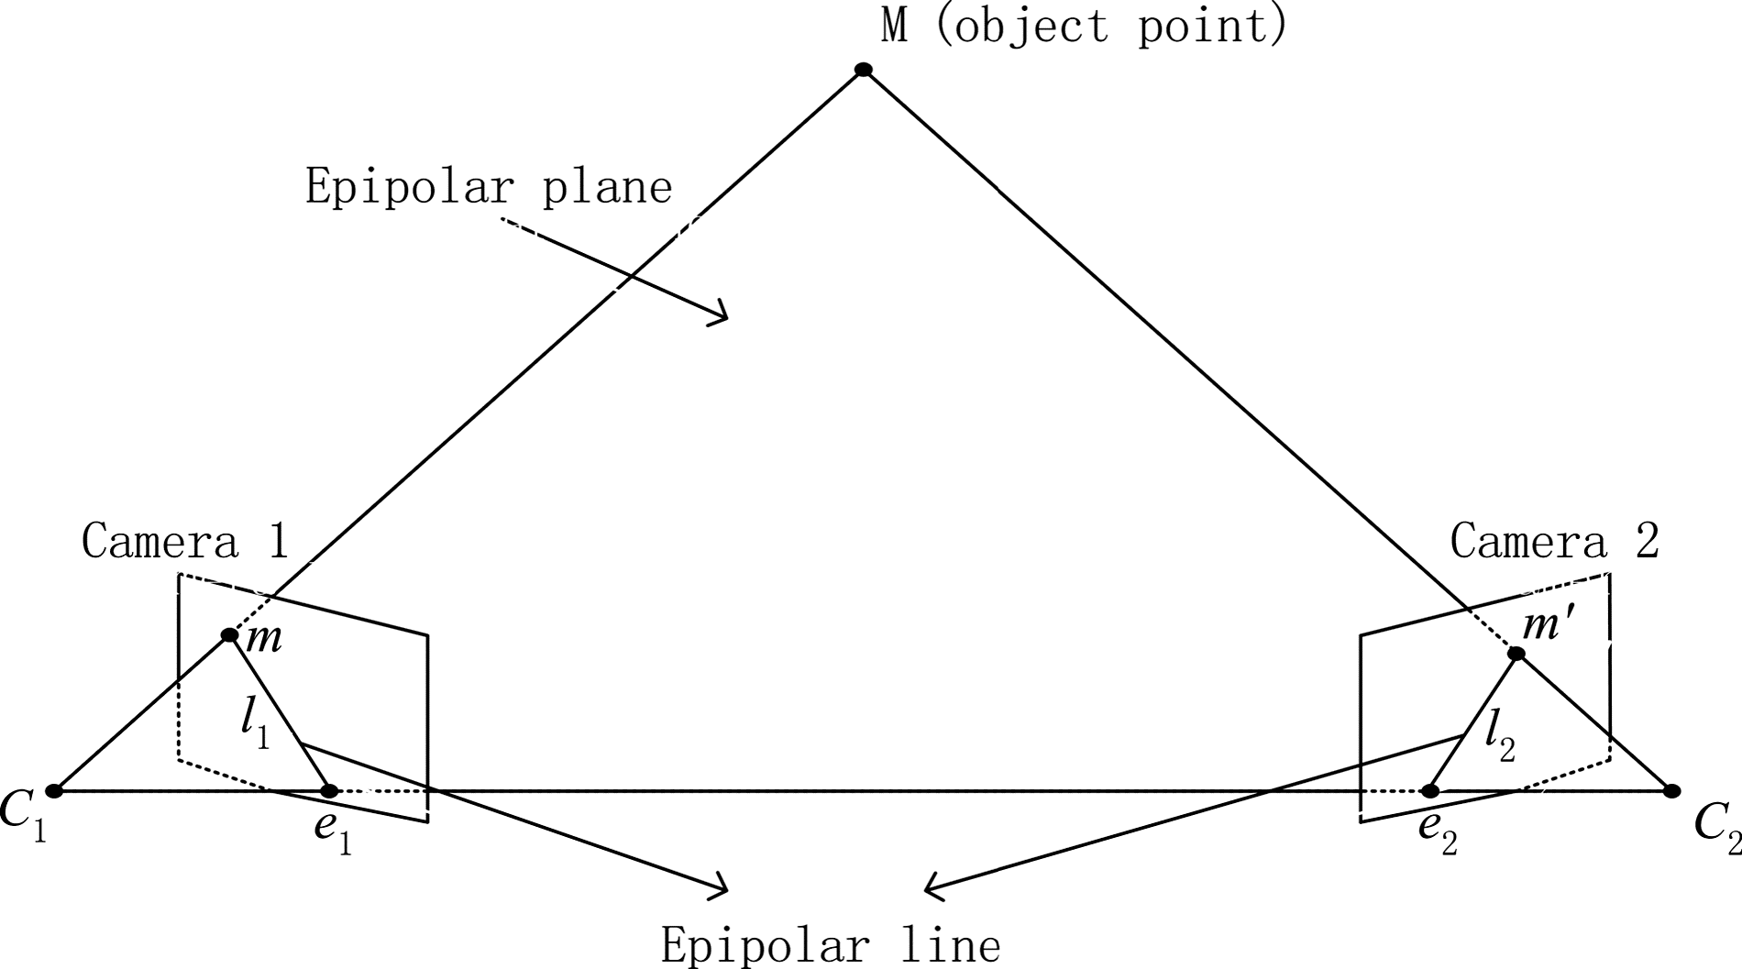
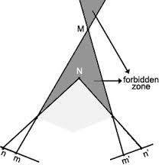
Stereo Matching Constraints

